Slide 1
Comparative genomics Bioinformatics Applications (PLPTH813)
Sanzhen Liu
4/1/2025

Slide 2
Outline
Introduction of comparative genomics
Approaches
Comparative genome hybridization
Paired-end reads
Read depth
Whole genome assembly
Homotools
Case study: CGRD

Slide 3
Comparative genomics among genomes
Conservation and variability
Homologs: DNA/protein sequences derived from a common ancester.
Orthologs: Homologs from divergent lineages.
Paralogs: Homologs derived from their duplication within a lineage.
Homeologs: The subset of paralogs created by WGD. (synonyms: ohnolog; syntenic paralog)

Slide 4
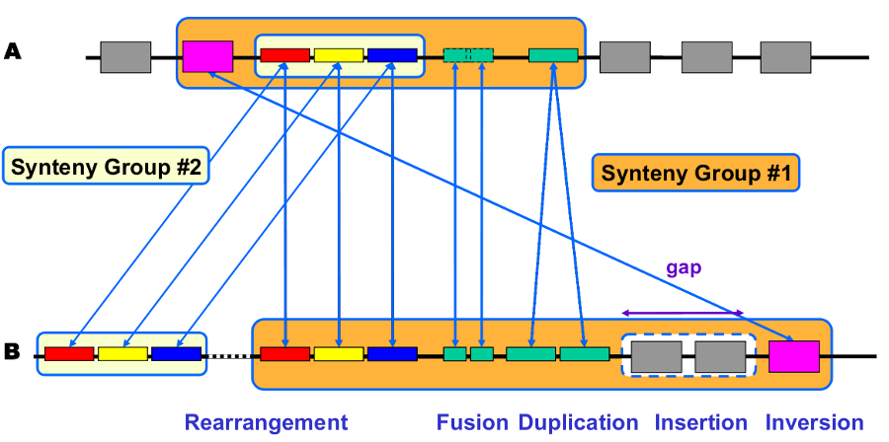
Synteny
Synteny is usually referred to as the conservation of blocks of order between two sets of chromosomes. Syntenic regions are evidenced by homologous genes arranged in a collinear order.
genoscope.cns.fr

Slide 5
Intra-species genome rearrangements and structural variation (SV)
Variation of 50 bp to several Mb in size
Balanced variation
- Inversion
- Translocation
Unbalanced variation:
- Copy number variation (CNV)
(Presence/Absence variation, PAV)

Slide 6
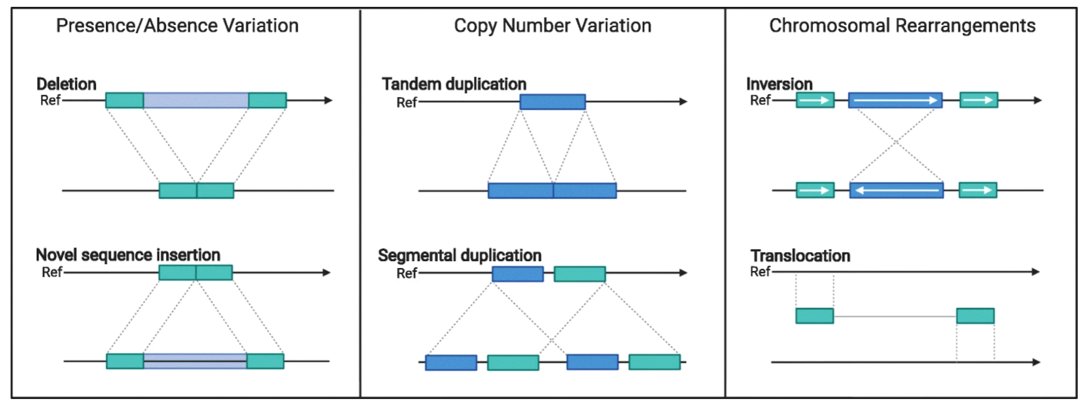
Structure variation types within species
Coletta et al., Genome Biol, 2021

Slide 7
Outline
Introduction of comparative genomics
Approaches
Comparative genome hybridization
Paired-end reads
Read depth
Whole genome assembly
Homotools
Case study: CGRD

Slide 8
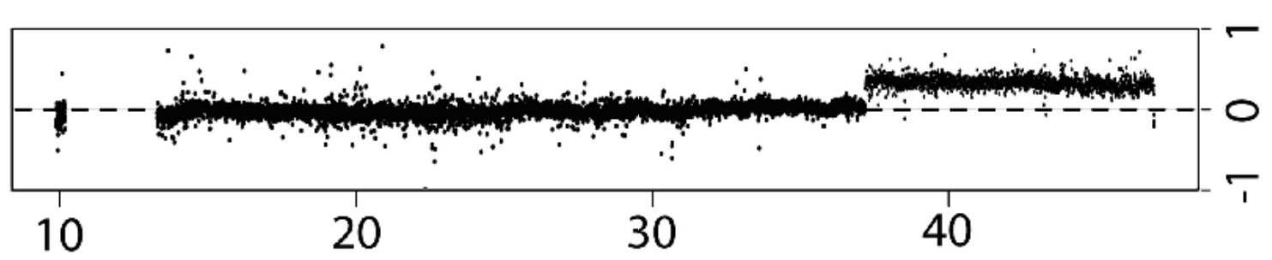
array Comparative Genomic Hybridization (aCGH)
A
+
B
array
Red signal (A)
Blue signal (B)
Log2 (A/B)

Slide 9
NGS provides information for the discovery of variants, including structural variation

Slide 10
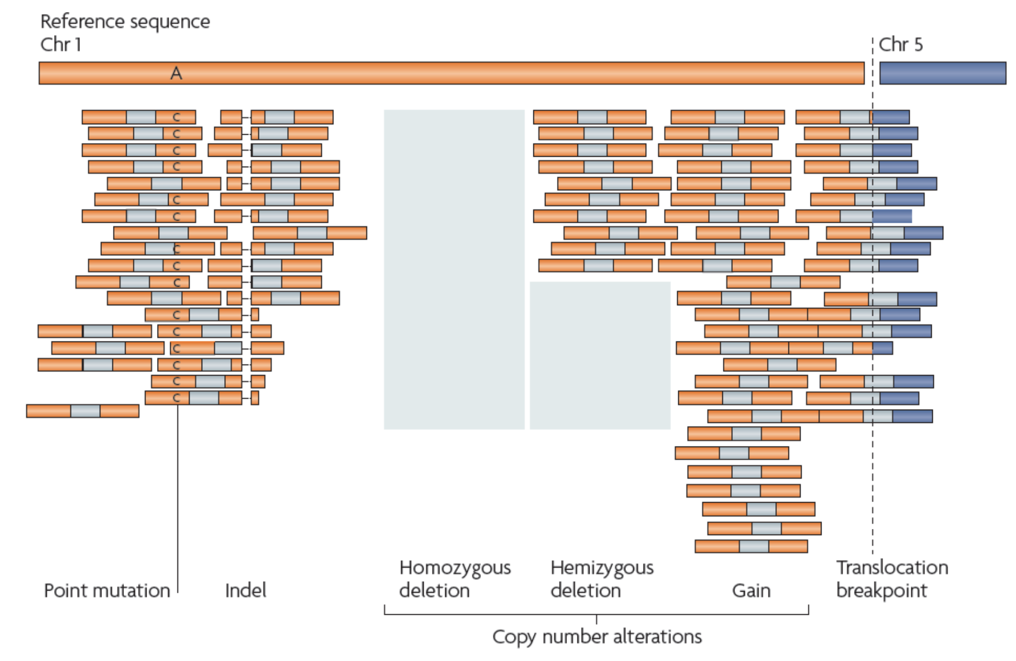
Variants in sequencing reads
Paired-end

Slide 11
Paired-end reads to find "deletion" relative to the reference
......
800 bp
Reference genome
newly sequenced genome
Paired-end read
insertion size = 380 bp

Slide 12
Split reads to find "exact deletion sequence"
Reference genome
......
Reads
Deletion sequence

Slide 13
Paired-end reads to find "insertion" relative to the reference
210 bp
Reference genome
newly sequenced genome
Paired-end read
insertion
fragment size = 380 bp
The size of insertions that can be identified by PE reads is determined by fragment sizes and read lengths.

Slide 14
inversion (I)
Reference genome
newly sequenced genome

Slide 15
inversion (II)
split read
Reference genome
newly sequenced genome

Slide 16
Tandem duplication
Reference genome
newly sequenced genome

Slide 17
Translocation
Reference genome
chrA
chrB
newly sequenced genome

Slide 18
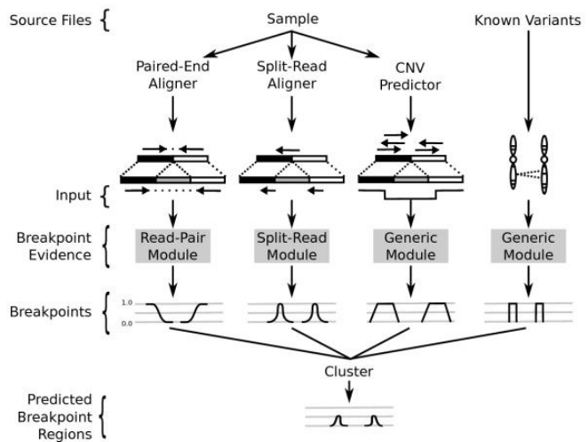
LUMPY: an integrative framework for SV discovery

Slide 19
Read depths
Reference
reads and alignment
copy number? 1 2 1 0 1
PCR bias (GC content, complicated structure)
Alignment bias (e.g., highly repetitive regions)
Nucleotide polymorphisms

Slide 20
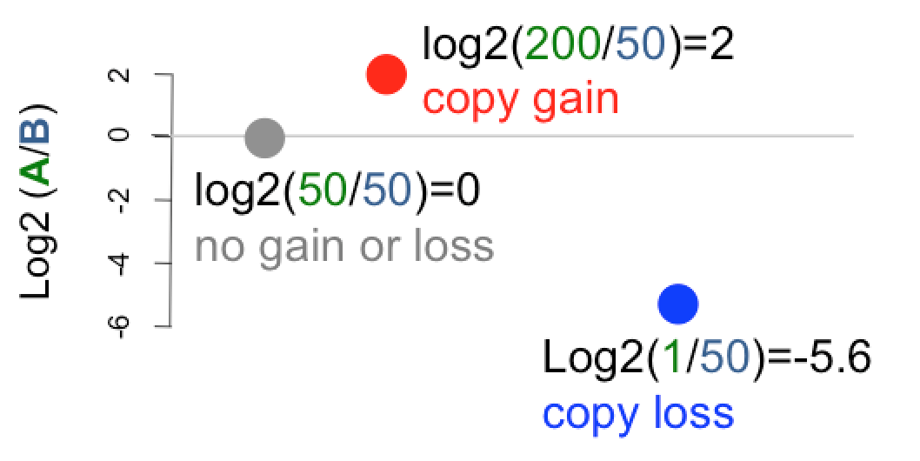
Read depths
B
A

Slide 21
Comparative Genomic Read Depth (CGRD)
CGRD is a pipeline to compare sequencing read depths from two samples along a reference genome.
define effective genomic bins each of which harbors certain non-repetitive sequences
align reads and count read depths per bin for both samples
combine neighboring bins with similar fold changes in read depth between the two samples (segmentation)

Slide 22
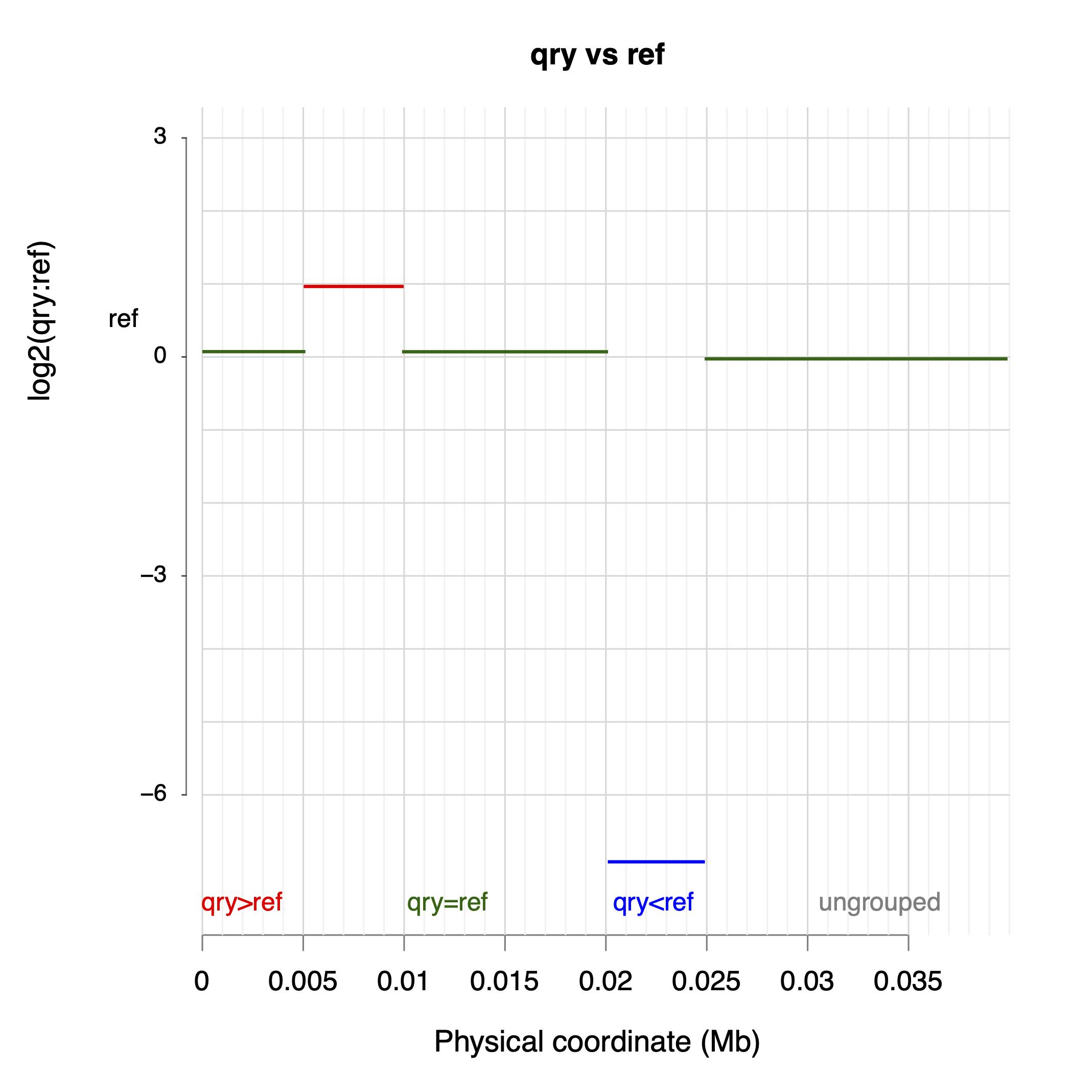
CGRD
#!/bin/bash
ref=./genome/ref.fasta
reffq1=./reads/ref.1.fastq
reffq2=./reads/ref.2.fastq
qryfq1=./reads/qry.1.fastq
qryfq2=./reads/qry.2.fastq
perl cgrd
--ref $ref \
--subj ref \
--sfq1 $reffq1 --sfq2 $reffq2 \
--qry qry \
--qfq1 $qryfq1 --qfq2 $qryfq2

Slide 23
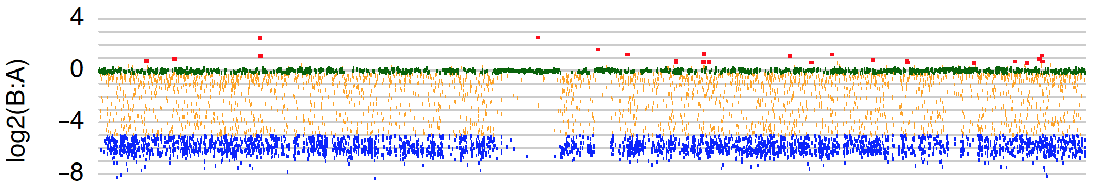
Comparative Genomic Read Depths (CGRD)
chr1
Physical coordinates
Red: B > A
Green: B = A
Blue: B < A

Slide 24
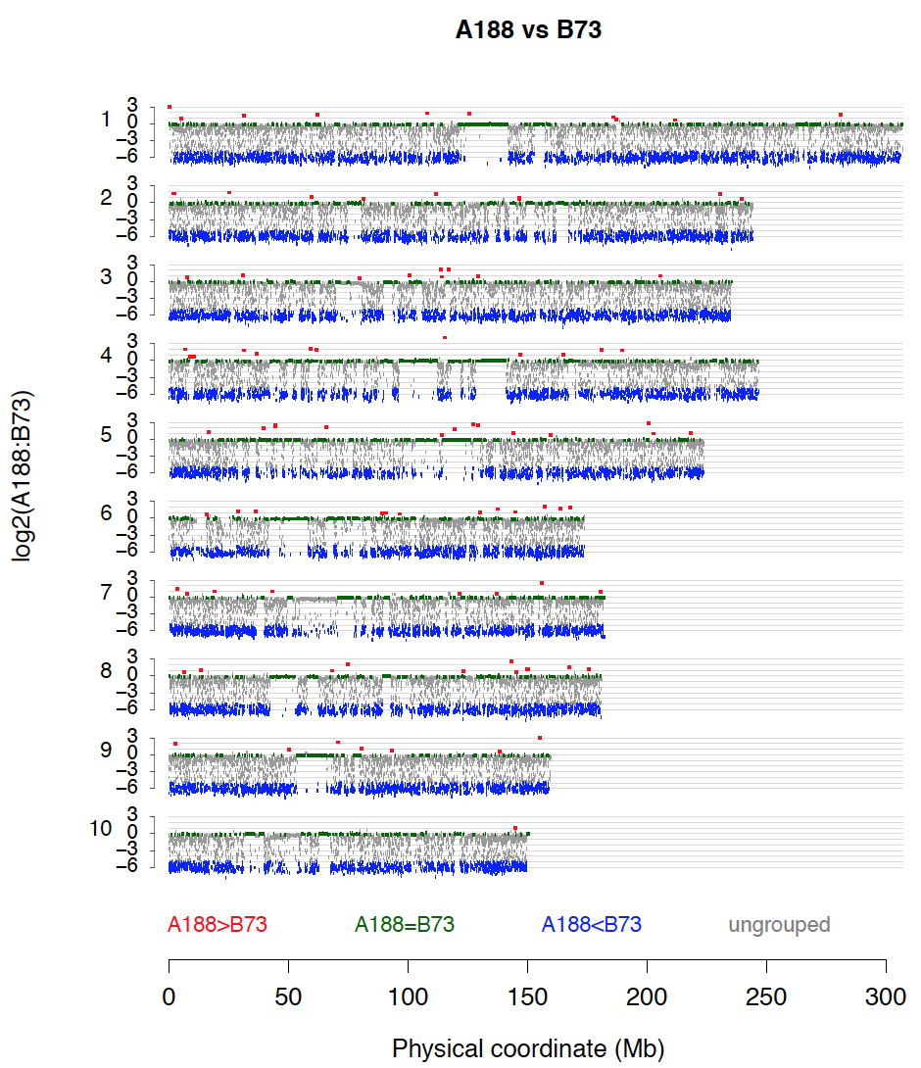
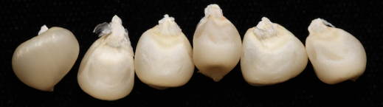
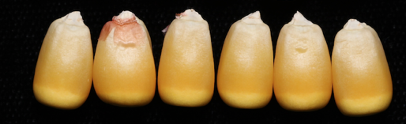
CGRD identified a CNV conditioning seed colors
?
Lin et al, Genome Biology, 2022

Slide 25
Outline
Introduction of comparative genomics
Approaches
Comparative genome hybridization
Paired-end reads
Read depth
Whole genome assembly
Homotools
Case study: CGRD

Slide 26

Whole genome alignments
Aligner: NUCmer or minimap2

Slide 27
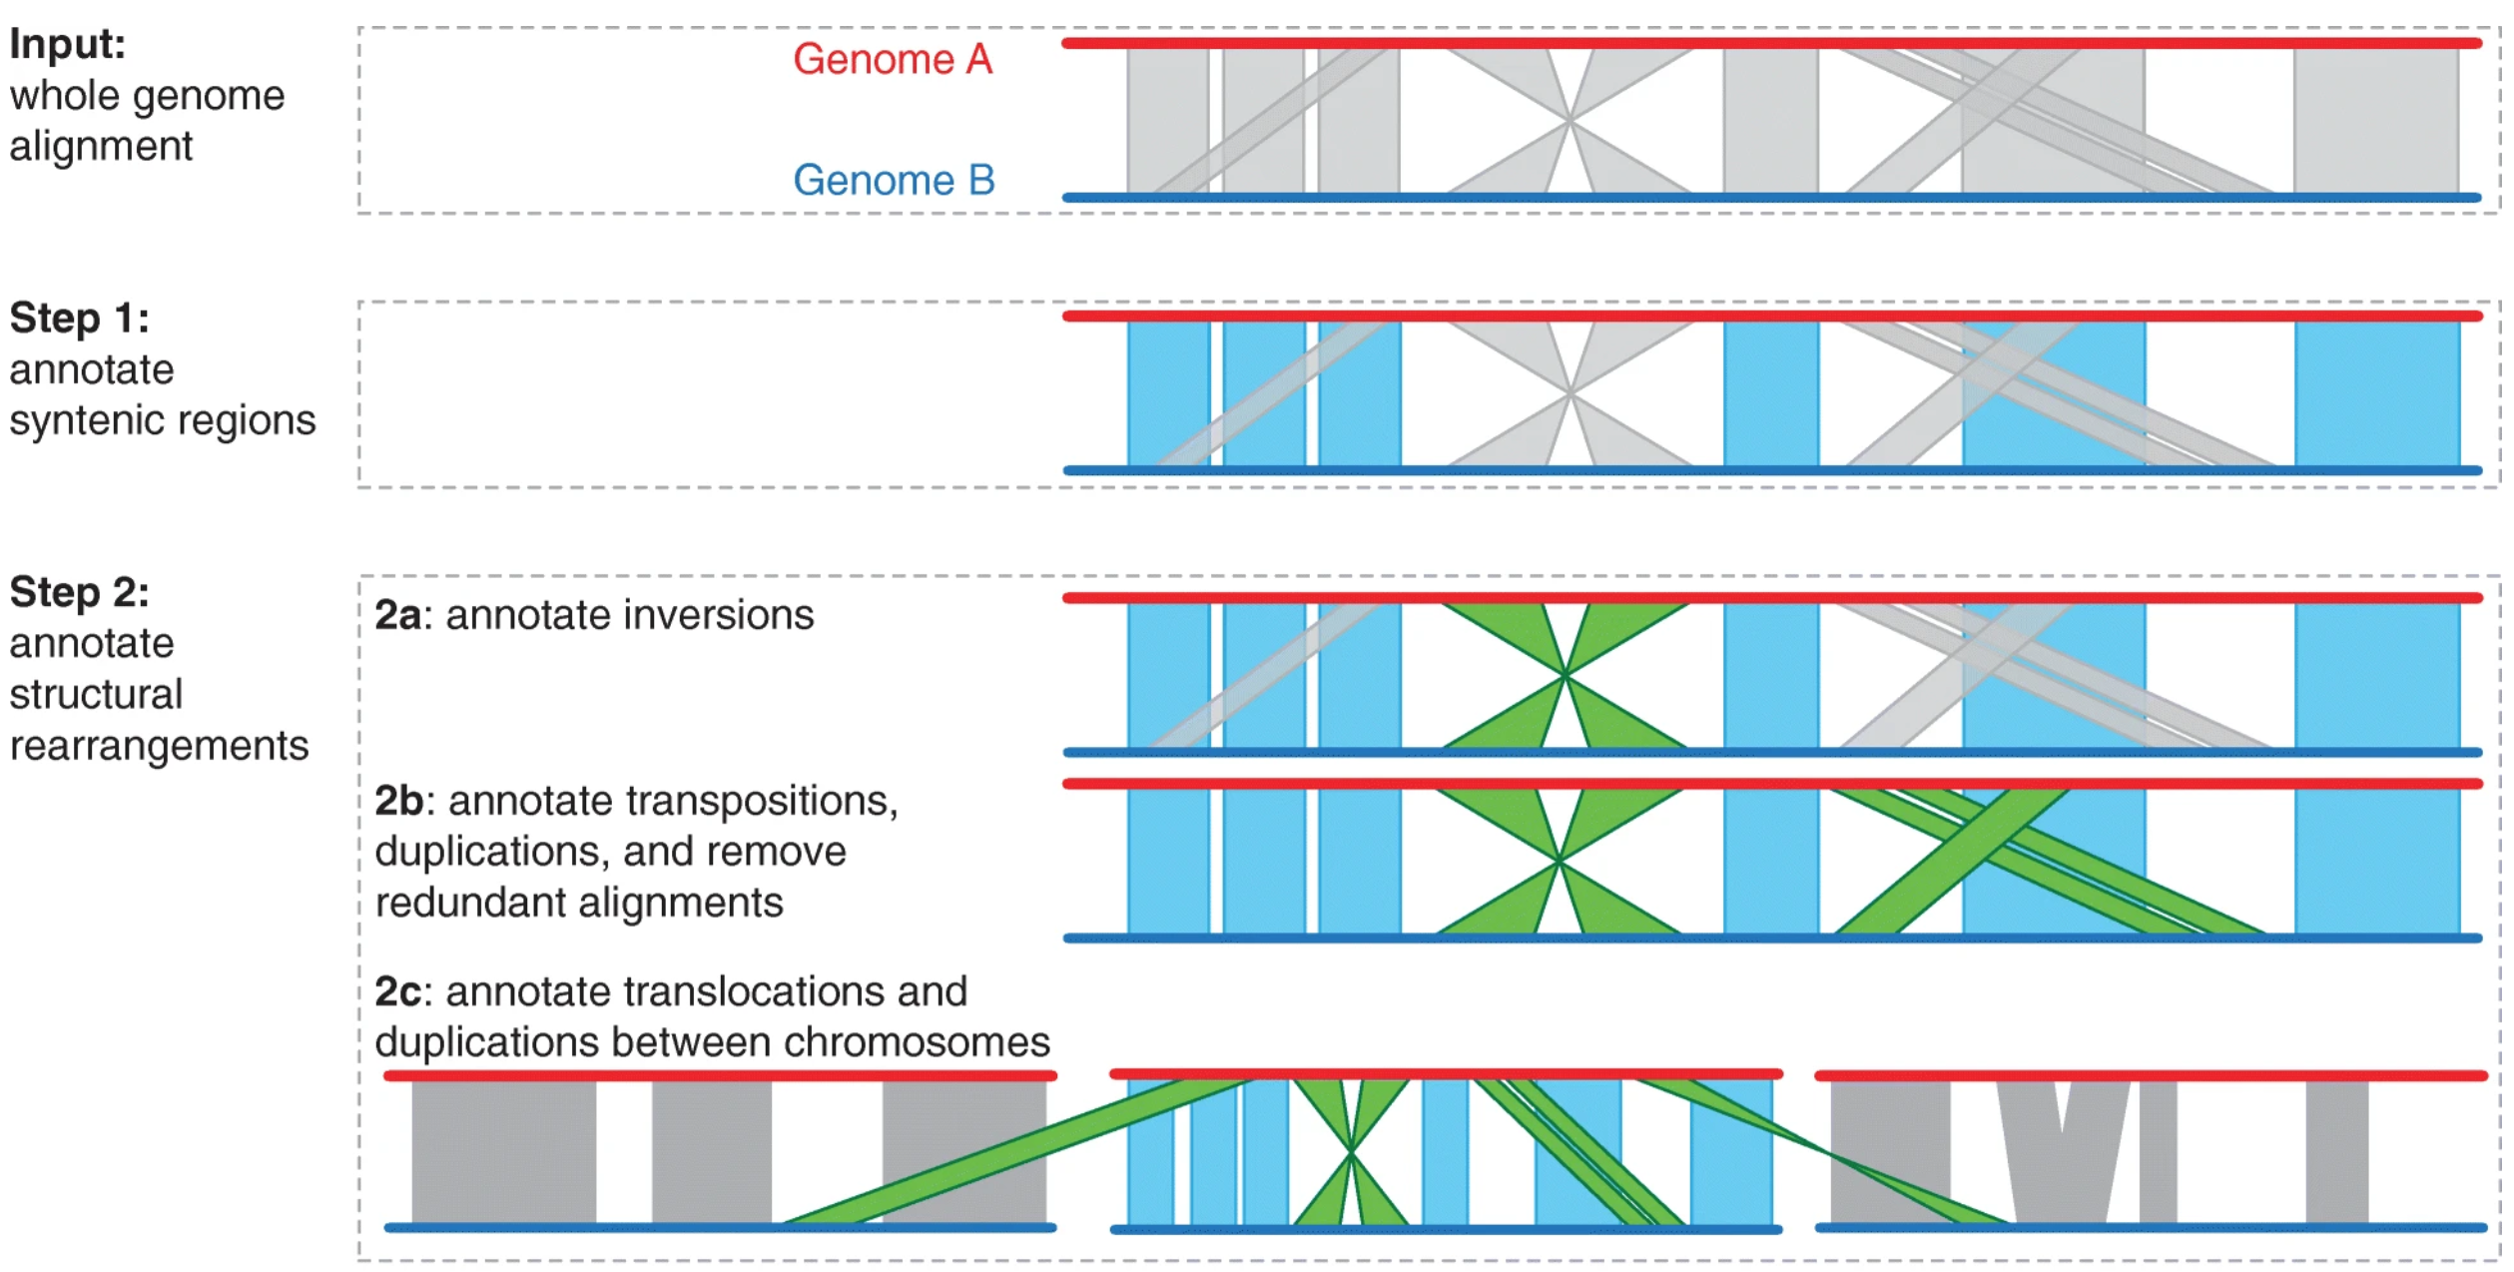
SyRI - finding genomic variation using genome assemblies
Goel et al, 2019, Genome Biology, 20:277

Slide 28
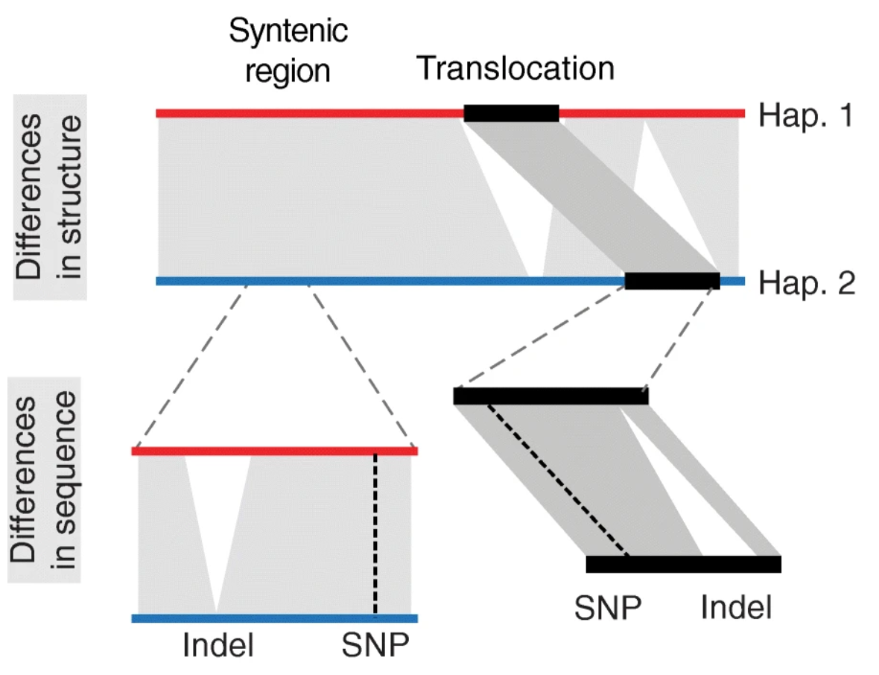
Find aligned syntenic and SV blocks and then discover differences in sequence
Notes:
Goel et al, 2019, Genome Biology, 20:277

Slide 29
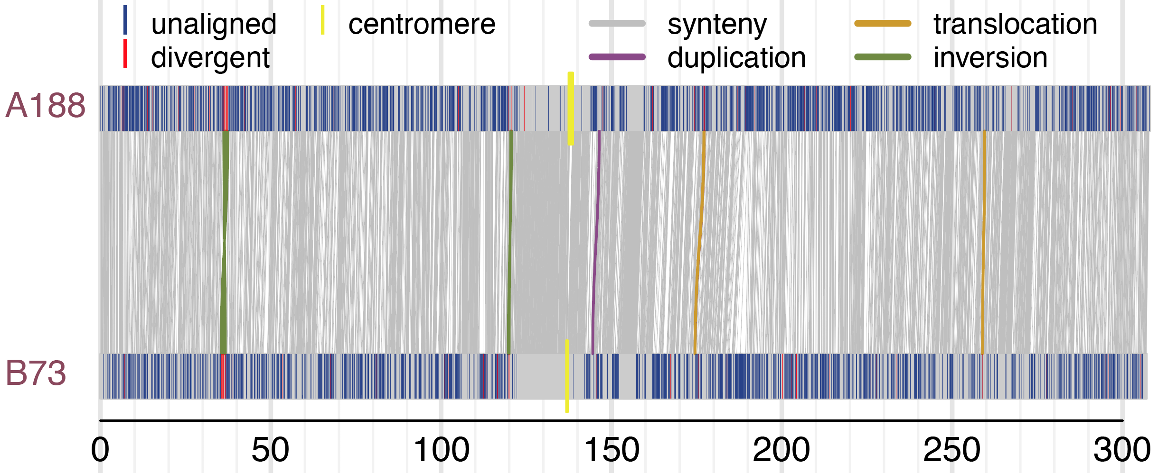
Structure variation with SyRI
SyRI is a tool using the genome assemblies to discover genomic rearrangement and local sequence differences (Goel et al., 2019)
Lin et al, Genome Biology, 2022
Notes:
Goel, M., Sun, H., Jiao, WB. et al. SyRI: finding genomic rearrangements and local sequence differences from whole-genome assemblies. Genome Biol 20, 277 (2019). https://doi.org/10.1186/s13059-019-1911-0

Slide 30
Outline
Introduction of comparative genomics
Approaches
Comparative genome hybridization
Paired-end reads
Read depth
Whole genome assembly
Homotools
Case study: CGRD

Slide 31
Homotools dedicated to identifying best homologs and conducting homologous comparisons
Issue: A procedure needs to be repeated frequently to extract gene sequences from a genome and compare with data from other genomes.
Can we make this procedure simpler?

Slide 32
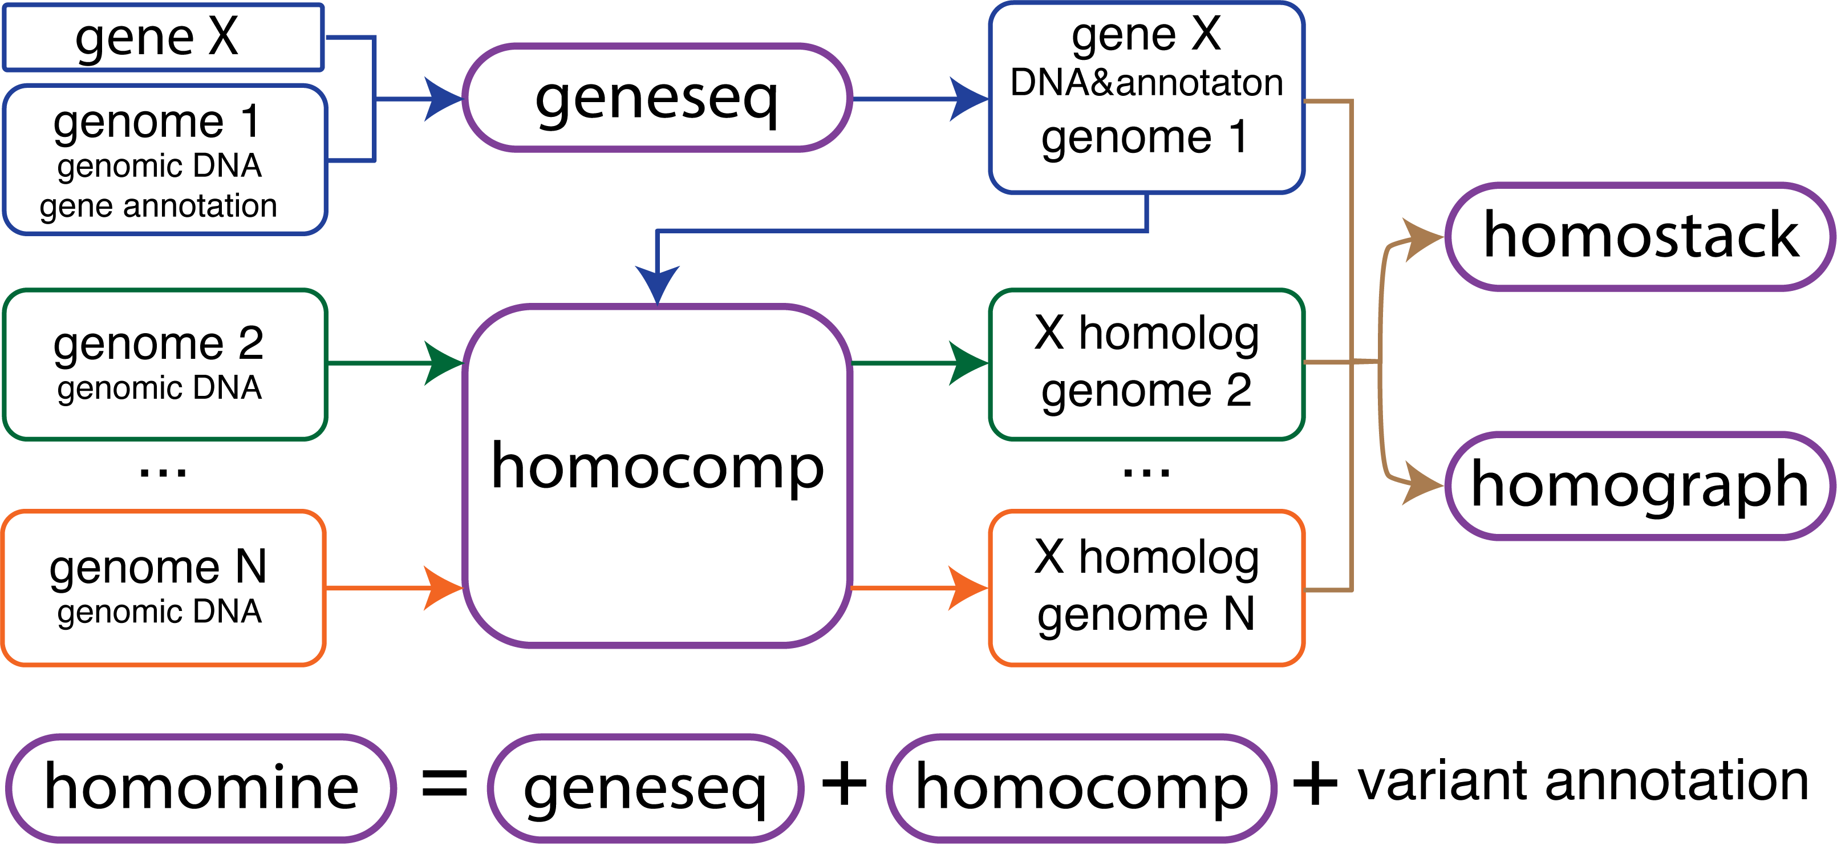
Multiple modules in homotools
1
4
2
5
3

Slide 33
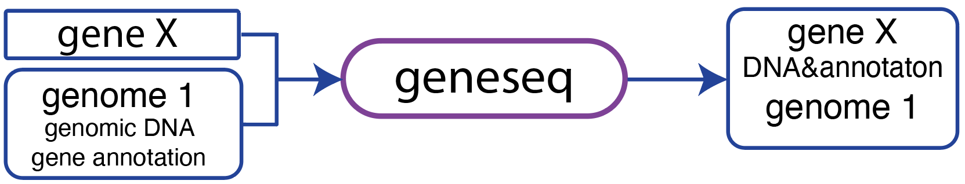
Geneseq
Annotation in the GTF format
geneseq --gene Zm00001eb001720 \
--fas B73.fasta \
--gtf B73.gtf

Slide 34
Extract other features
--cds : cds database
--cdna : transcript database
--protein : protein database
--ext5 : bp extension from 5' site
--ext3. : bp extension from 3' site

Slide 35
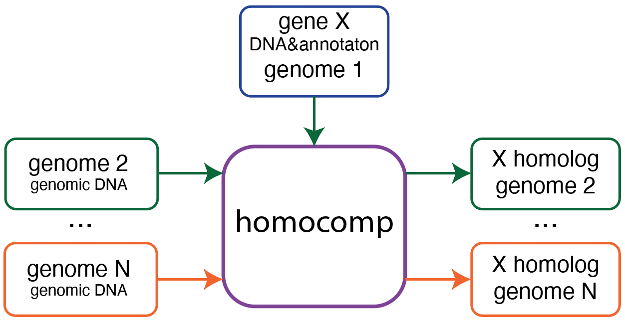
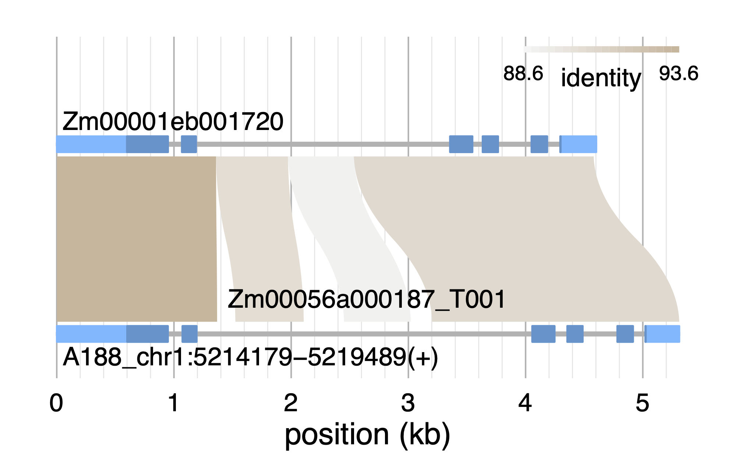
homocomp: search for the best homolog and compare
homocomp \
--query Zm00001eb001720.fasta \
--qryadd Zm00001eb001720_T001.adjusted.bed \
--db A188 \
--tgtf A188.gtf
geneseq

Slide 36
homomine
Start from a gene ID in a genome (e.g., B73)
Search the best homolog in a targeted genome (e.g., A188)
Identify polymorphisms, including SNP, INDEL, and structural variation (SV)
Annotate all polymorphisms
Determine if an SV is associated with a transposon
Show all these results in a HTML report
Notes:
Zm00001eb225110
Zm00001eb225130
Zm00001eb225150

Slide 37
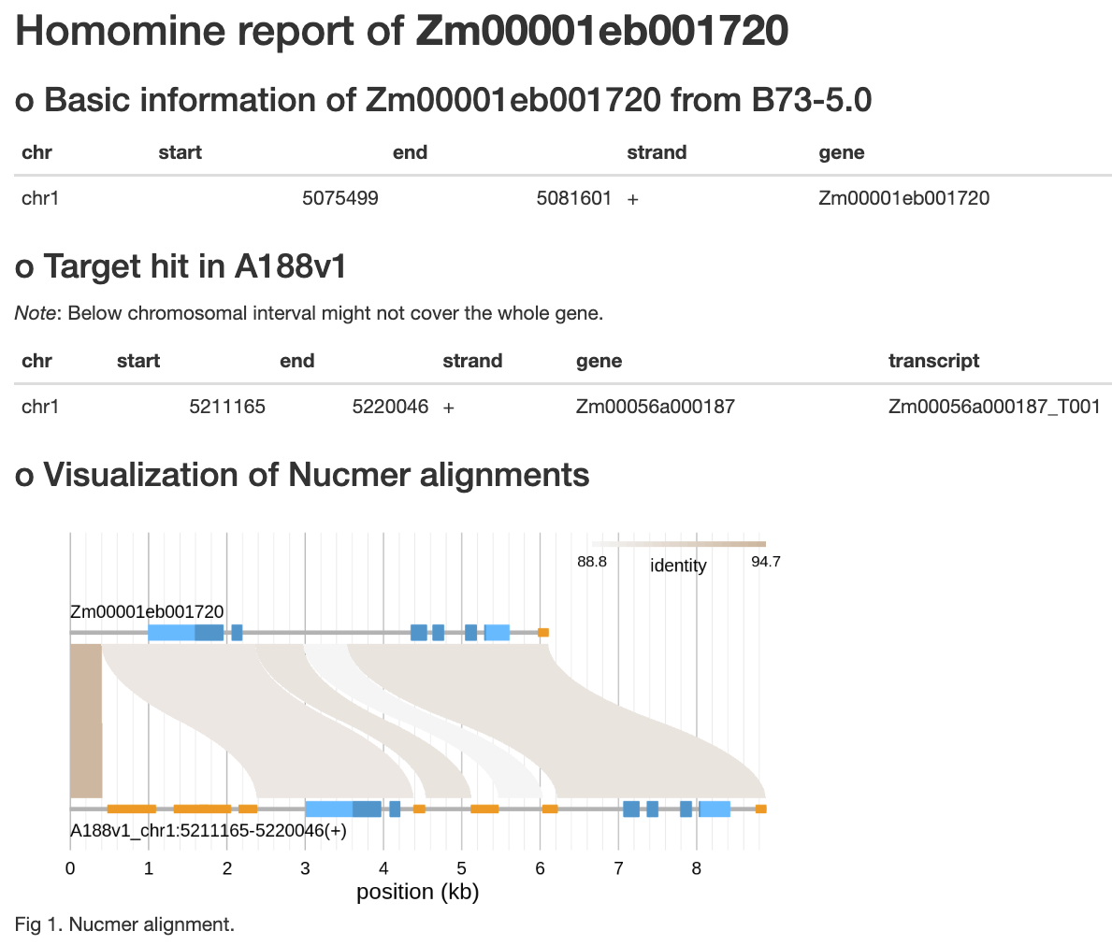
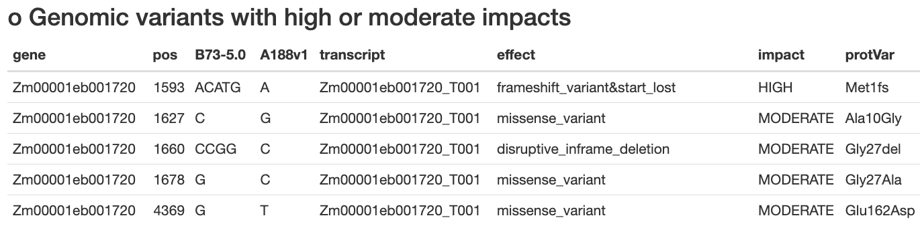
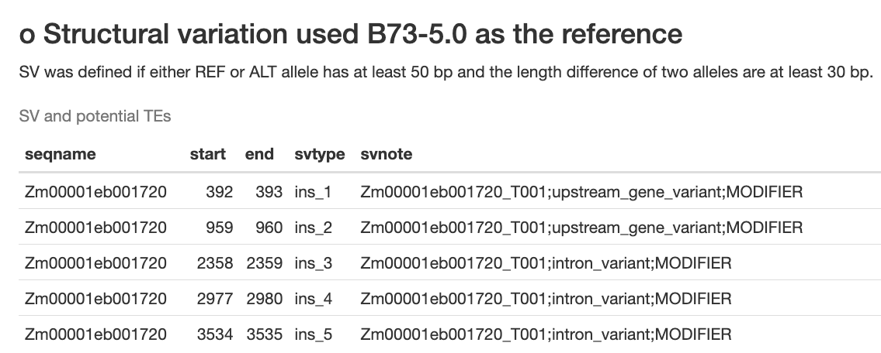
Homomine of maize B73 gene Zm00001eb001720
1981 bp

Slide 38
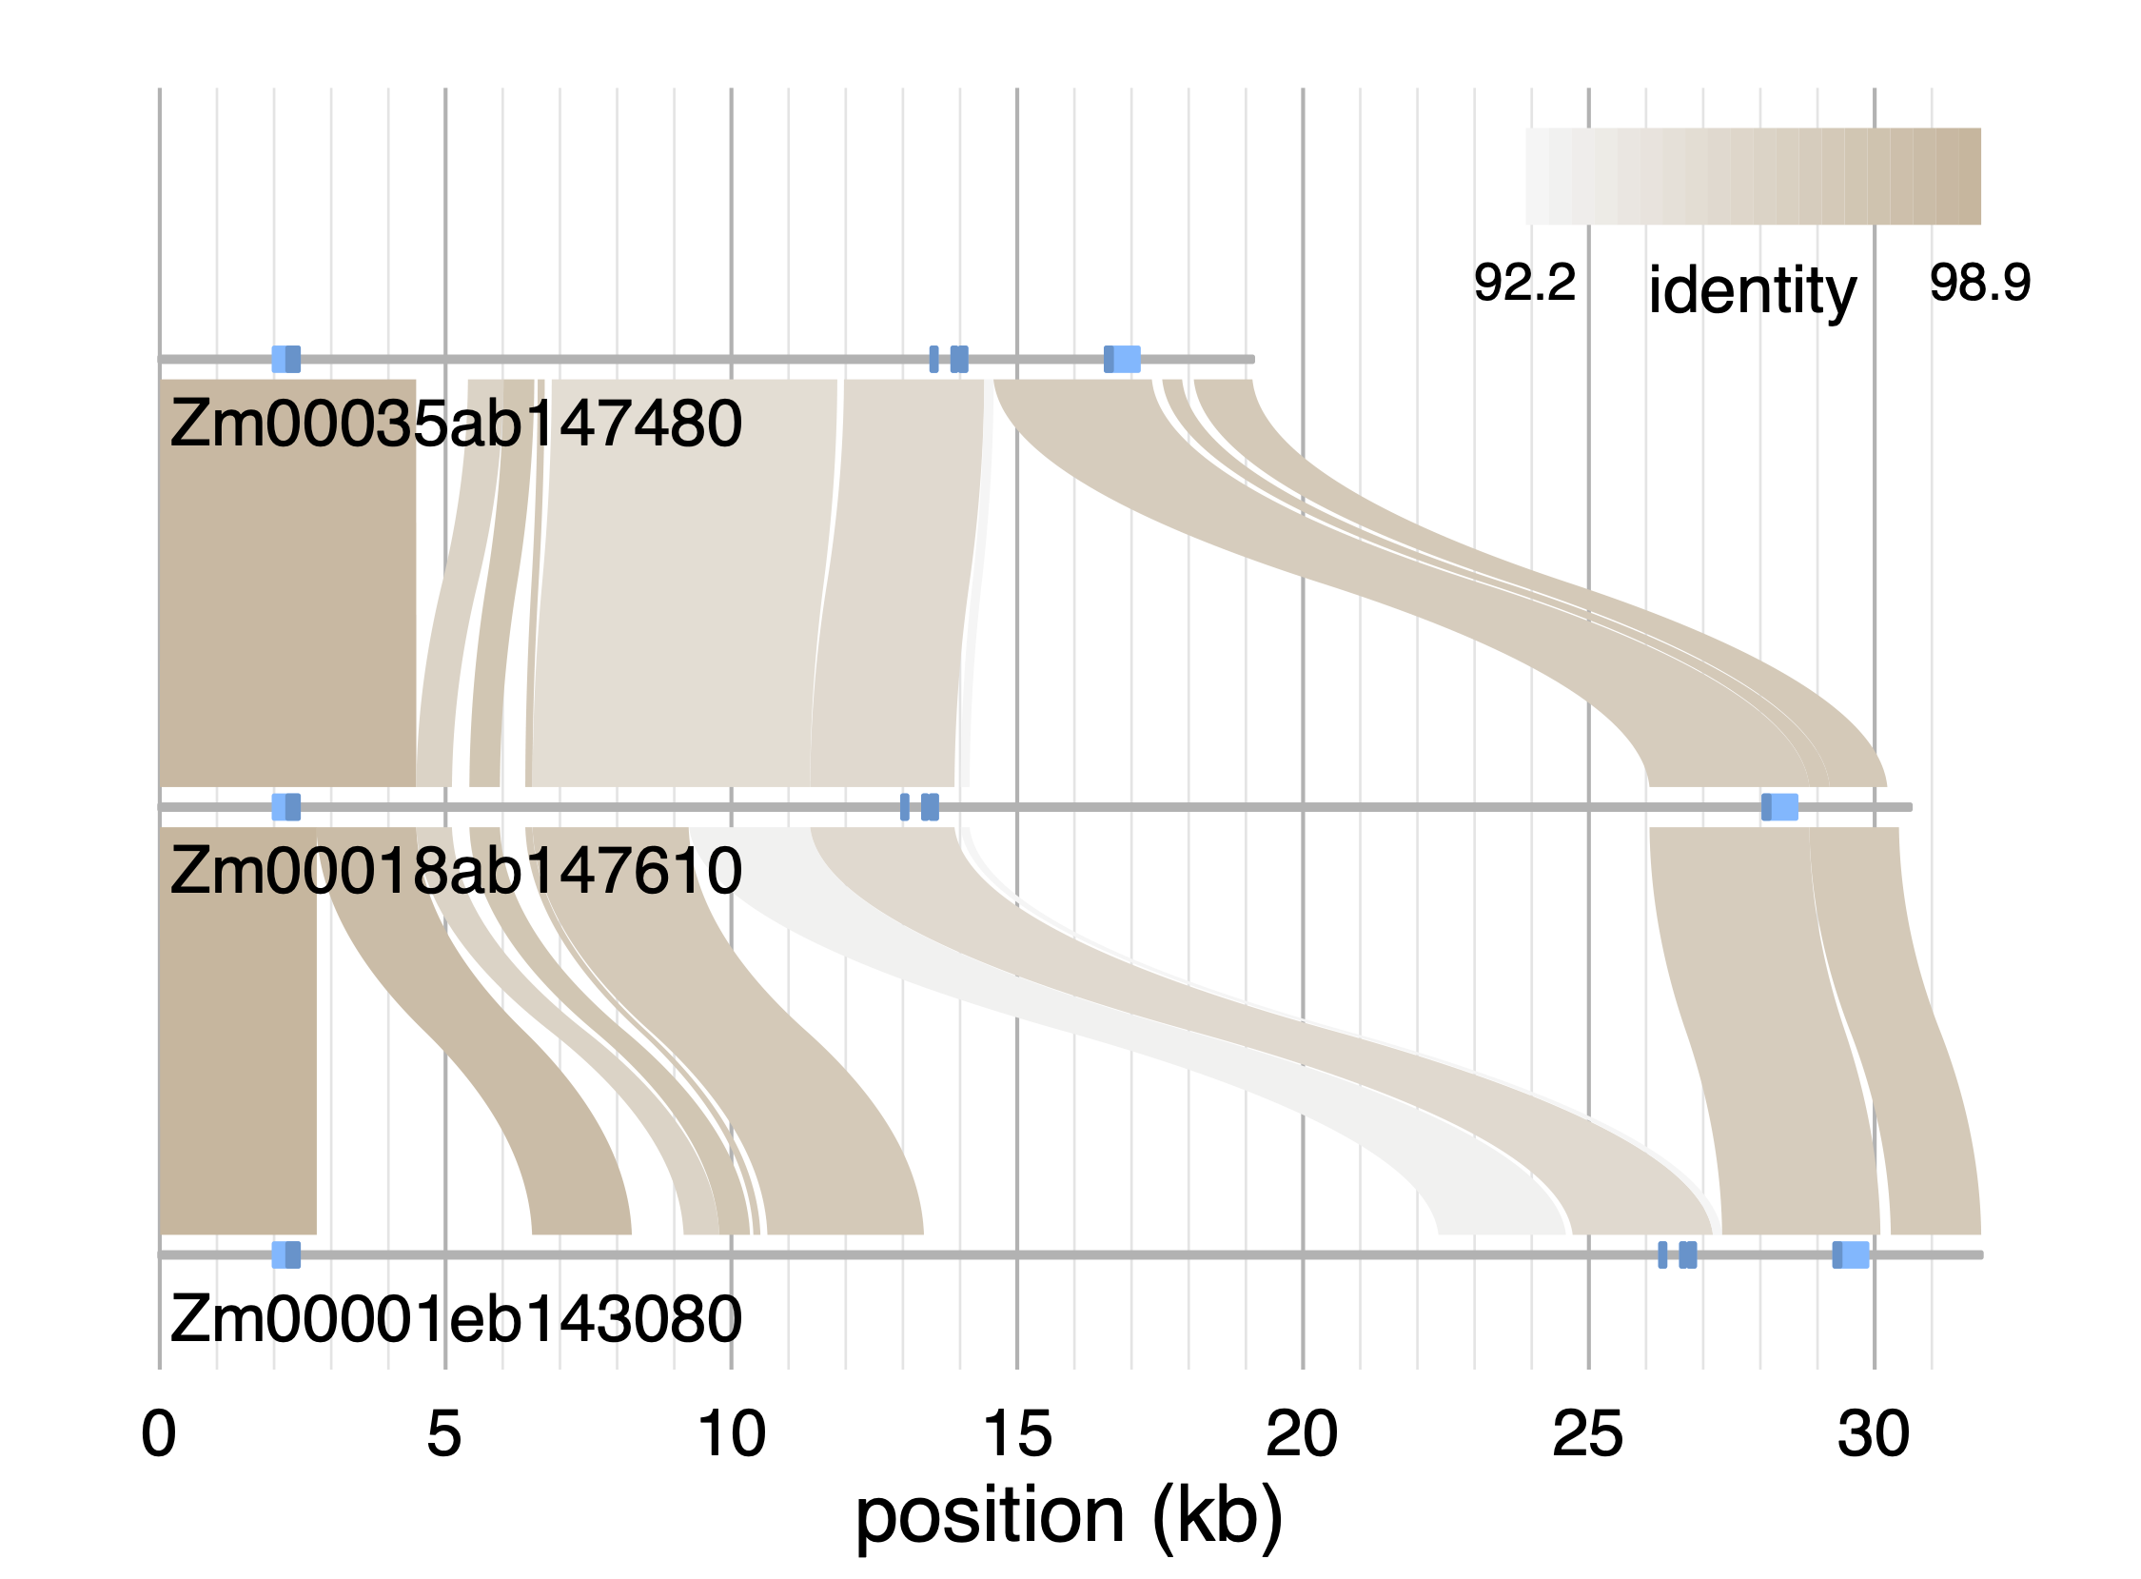
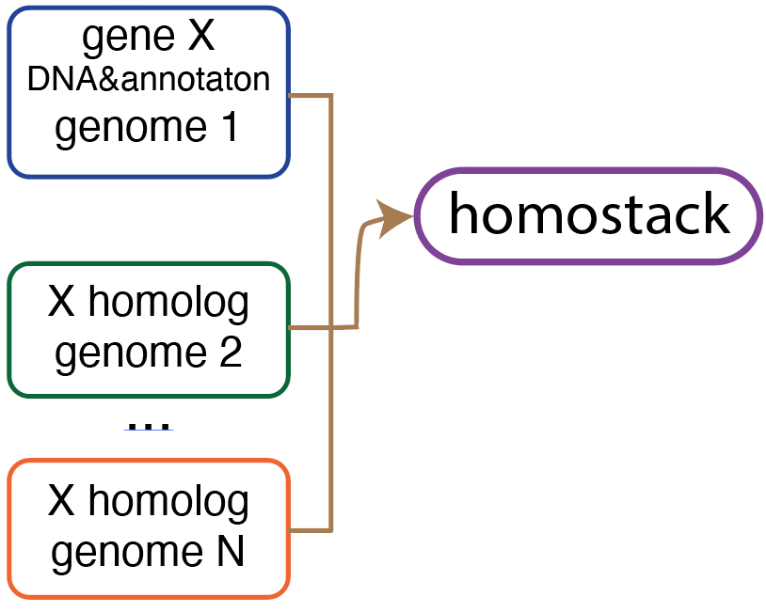
homostack: alignment visualization of multiple sequences

Slide 39
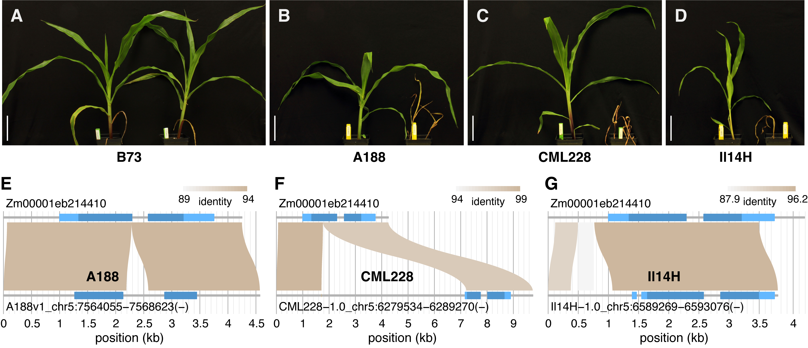
Case study – herbicide (nicosulfuron) resistance
B73
B73
B73

Slide 40
Outline
Introduction of comparative genomics
Approaches
Comparative genome hybridization
Paired-end reads
Read depth
Whole genome assembly
Homotools
Case study: CGRD

Slide 41
MoT B71 final assembly vs. MG8 (70-15, rice strain)
Wheat blast fungus
Chr | Length (bp)
chr1 | 6,442,091
chr2 | 7,902,655
chr3 | 8,206,304
chr4 | 5,402,116
chr5 | 4,442,877
chr6 | 6,090,985
chr7 | 4,042,640
scaf1 | 941,816
scaf2 | 739,928
scaf3 | 104,670
scaf4 | 74,396
scaf5 | 69,131
Wheat
blast fungal strain
rice blast fungal reference
>10 kb overlap and >95% identity
Notes:
the two genomes are largely co-linear except for a few rearrangements, insertions, inversions.

Slide 42
Illumina sequencing of additional eight strains
Name | Year isolated | Host species | Isolation location
T25 | 1988 | Triticum | Paraná, Brazil
Py5020 | 2005 | Triticum | Paraná, Brazil
Py22.1 | 2007 | Triticum | Paraná, Brazil
B2 | 2011 | Triticum | Quirusillas, Bolivia
B71 | 2012 | Triticum | Okinawa, Bolivia
P3 | 2012 | Triticum | Canindeyú,Paraguay
P28 | 2014 | Bromus | Paraguay
P29 | 2014 | Bromus | Paraguay
B51 | 2012 | Eleusine | Quirusillas, Bolivia

Slide 43
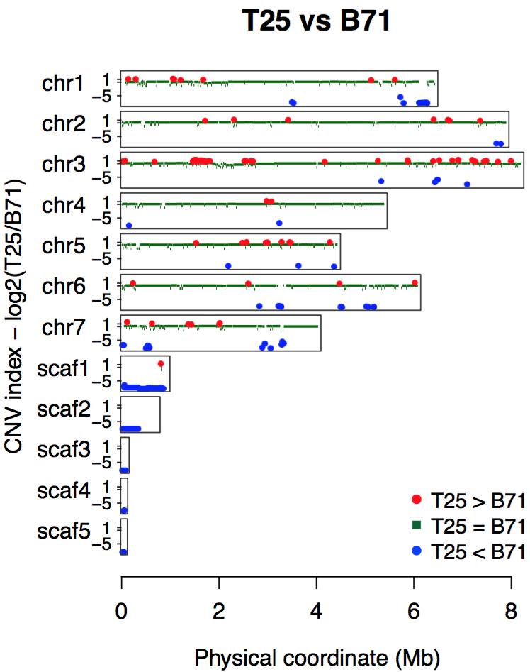
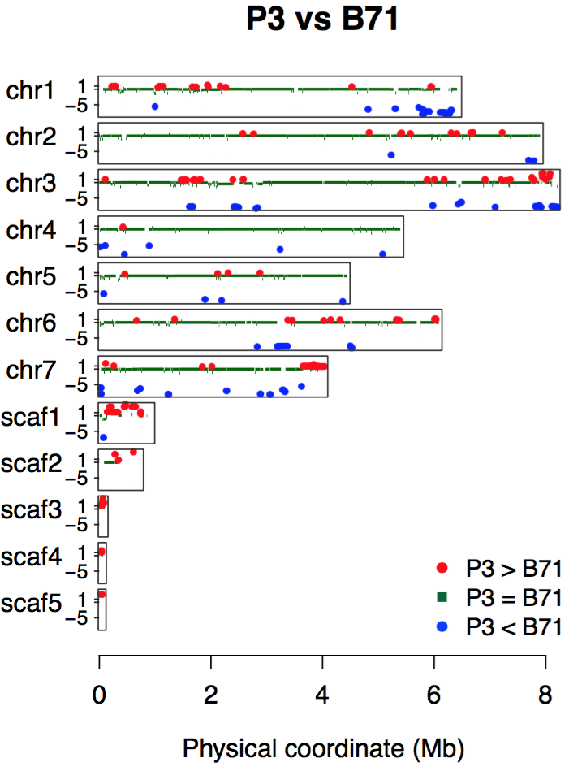
CGRD to infer copy number variation
two mini-chromosomes?
Simply consider:
red: two copies in T25
green: conserved
blue: no copies in T25
no minis?

Slide 44
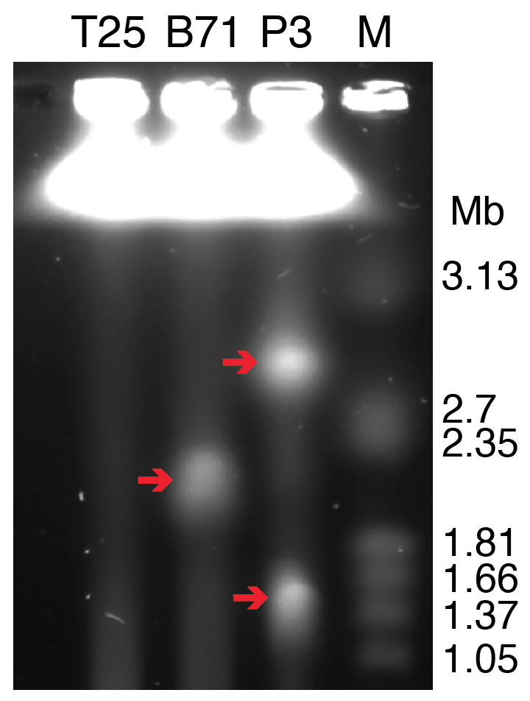
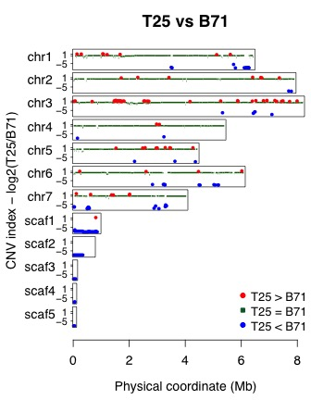
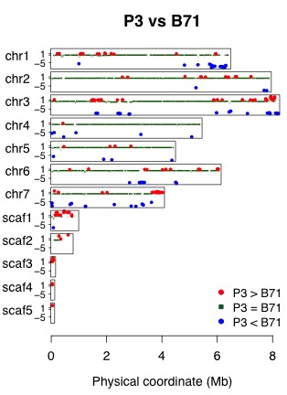
CHEF gel to separate chromosome-sized DNA
T25 has no mini-chromosomes
B71 has one and P3 has two
Notes:
the CNV results of scaffolds 1-5 match the mini-chromosome pattern

Slide 45
Additional References
Pinkel, D. & Albertson, D. G. Comparative genomic hybridization. Annu. Rev. Genomics Hum. Genet. 6, 331–354 (2005).
Miller, W., Makova, K. D., Nekrutenko, A. & Hardison, R. C. Comparative genomics. Annu. Rev. Genomics Hum. Genet. 5, 15–56 (2004).
Korbel, J. O. et al. Paired-end mapping reveals extensive structural variation in the human genome. Science 318, 420–426 (2007).
Armstrong, J., Fiddes, I. T., Diekhans, M. & Paten, B. Whole-Genome Alignment and Comparative Annotation. Annu Rev Anim Biosci (2018). doi:10.1146/annurev-animal-020518-115005
Kronenberg, Z. N. et al. High-resolution comparative analysis of great ape genomes. Science 360, (2018).

Slide 46
Pangenome
The pangenome represents the entire set of genes genomes within a species, consisting of a core genome — containing sequences shared between all individuals of the species — and the ‘dispensable’ genome.
(https://www.nature.com/articles/d42859-020-00115-3)

Slide 47
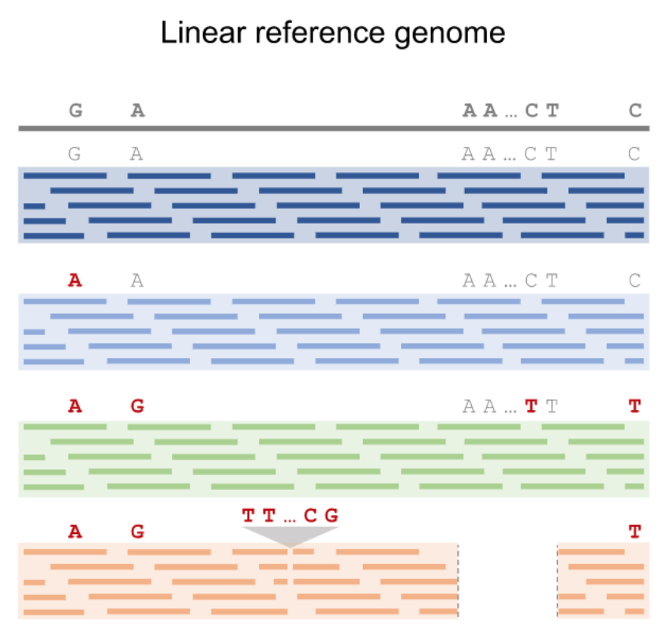
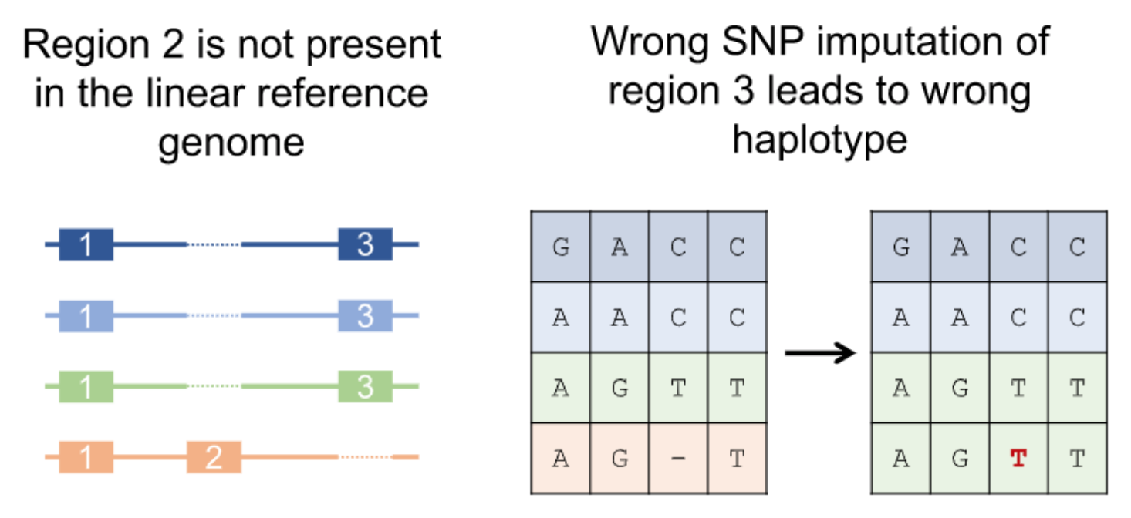
Issues associated with single reference genomes
Coletta et al., Genome Biol, 2021

Slide 48
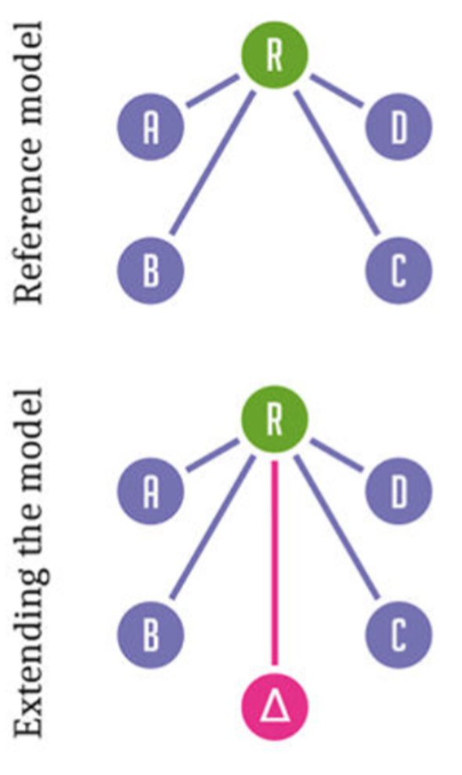
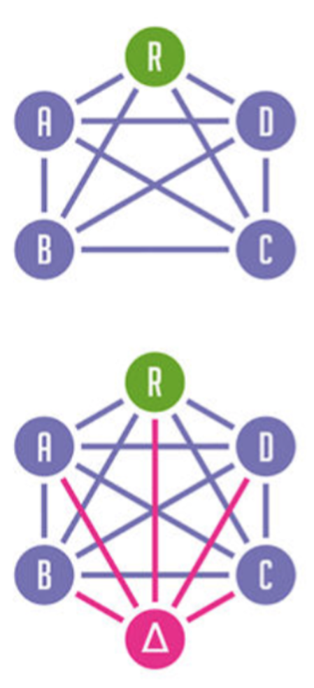
Pangenomics
Eizenga et al., 2020, Annual Review of Genomics and Human Genetics, 21:139-162

Slide 49
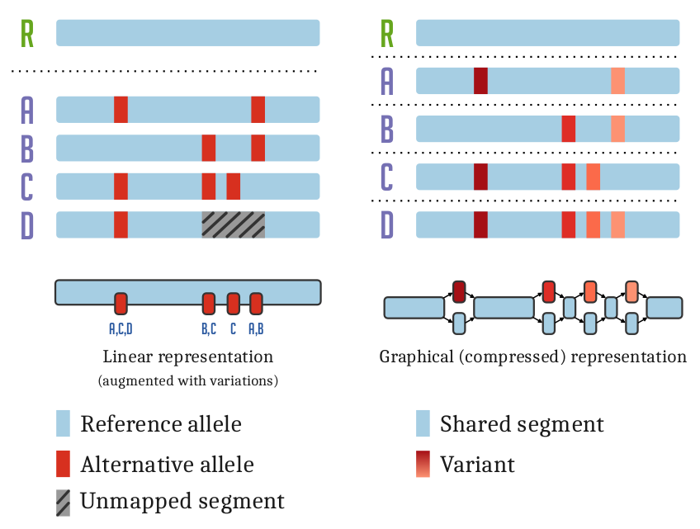
Variant graph
The variation graph data model describes the all-to-all alignment of many sequences

Slide 50
Tool collection

Slide 51
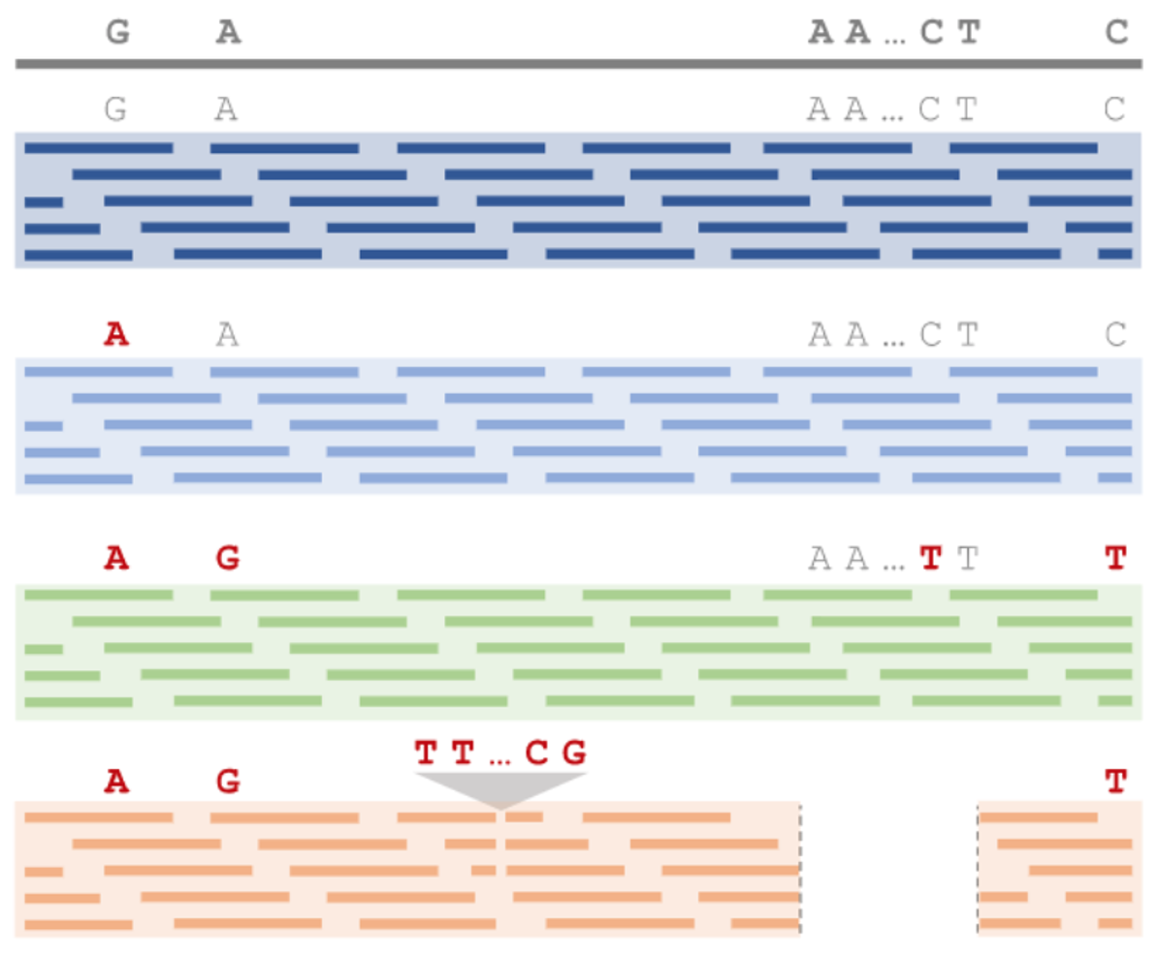
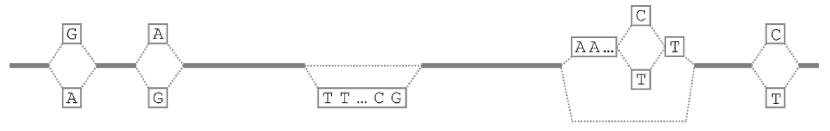
Construct a pangenome to facilitate genotyping

